Slide 1
Data Science Salaries

Slide 2
agenda
INTRODUCTION 3
DATASET 4
DATA PREPROCESSING 5
INTERACTIVE SHINY DASHBOARD
STATIC VISUALIZATIONS WITH GGPLOT2

Slide 3

introduction
The Data Science Job Salaries Dataset is a comprehensive collection that provides insights into the compensation landscape of professionals in the field of data science. This dataset comprises 11 columns, each meticulously curated to offer a nuanced perspective on various aspects of employment and remuneration.

Slide 4
Dataset

Slide 5
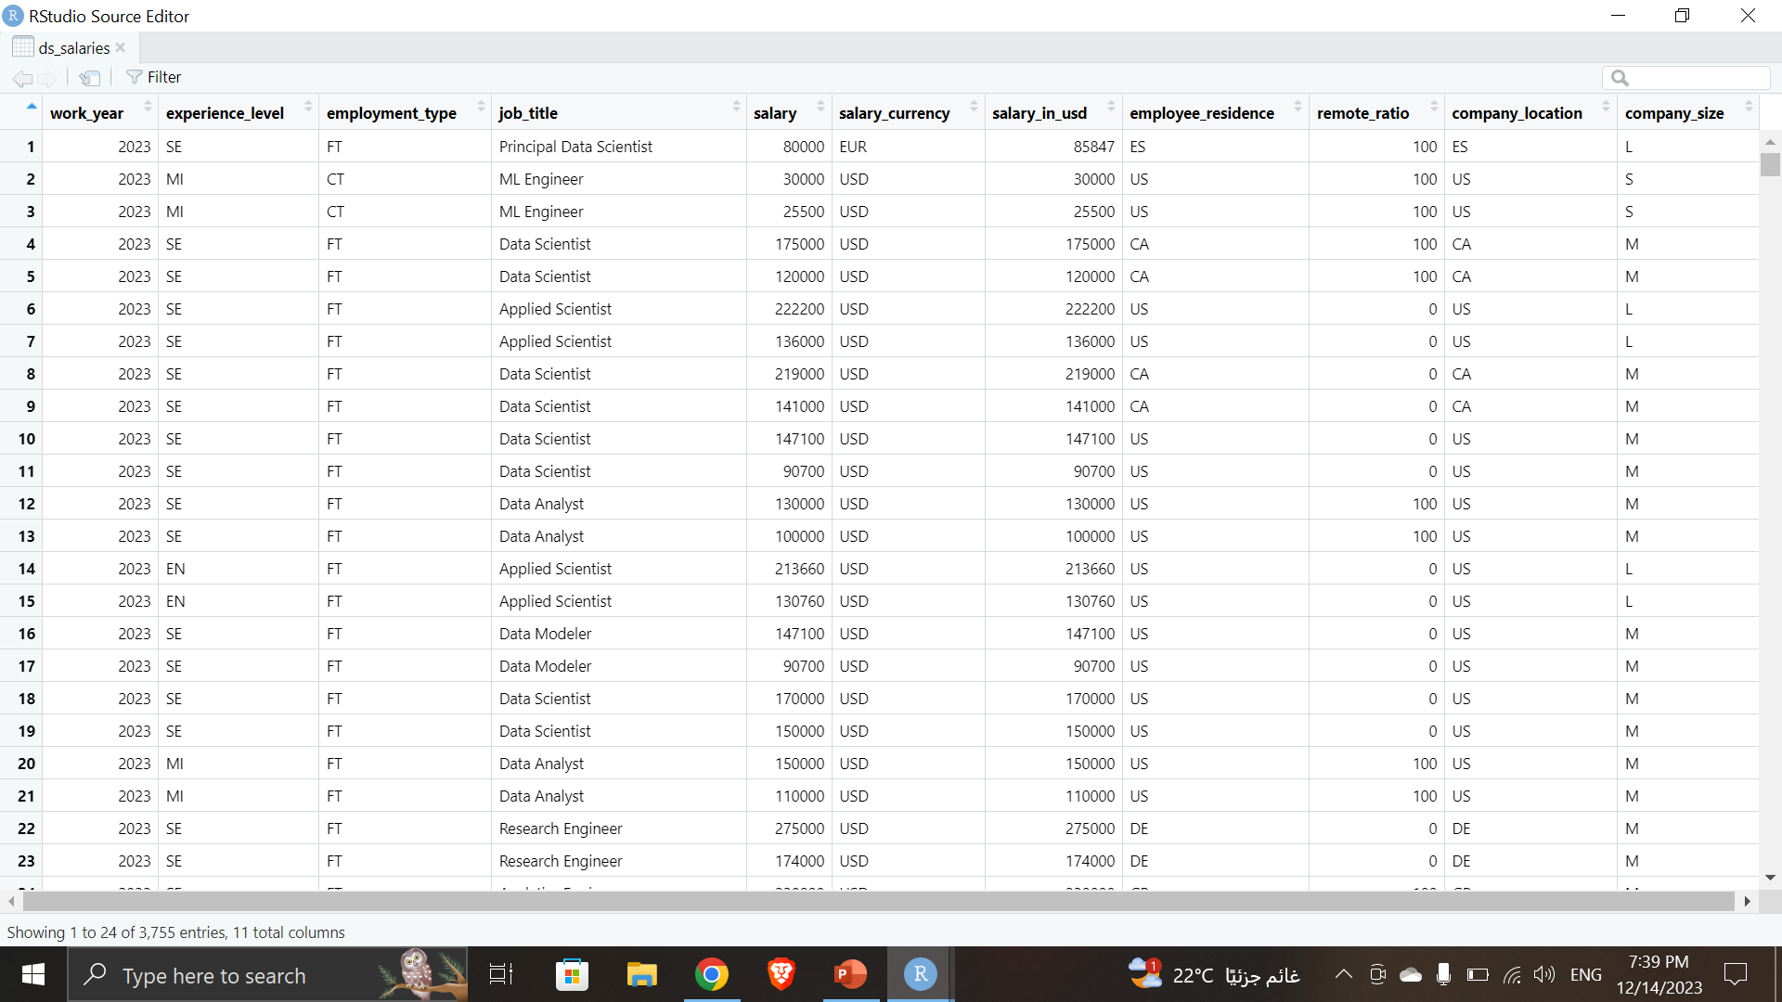
Dataset

Slide 6
Data PreProcessing

Slide 7
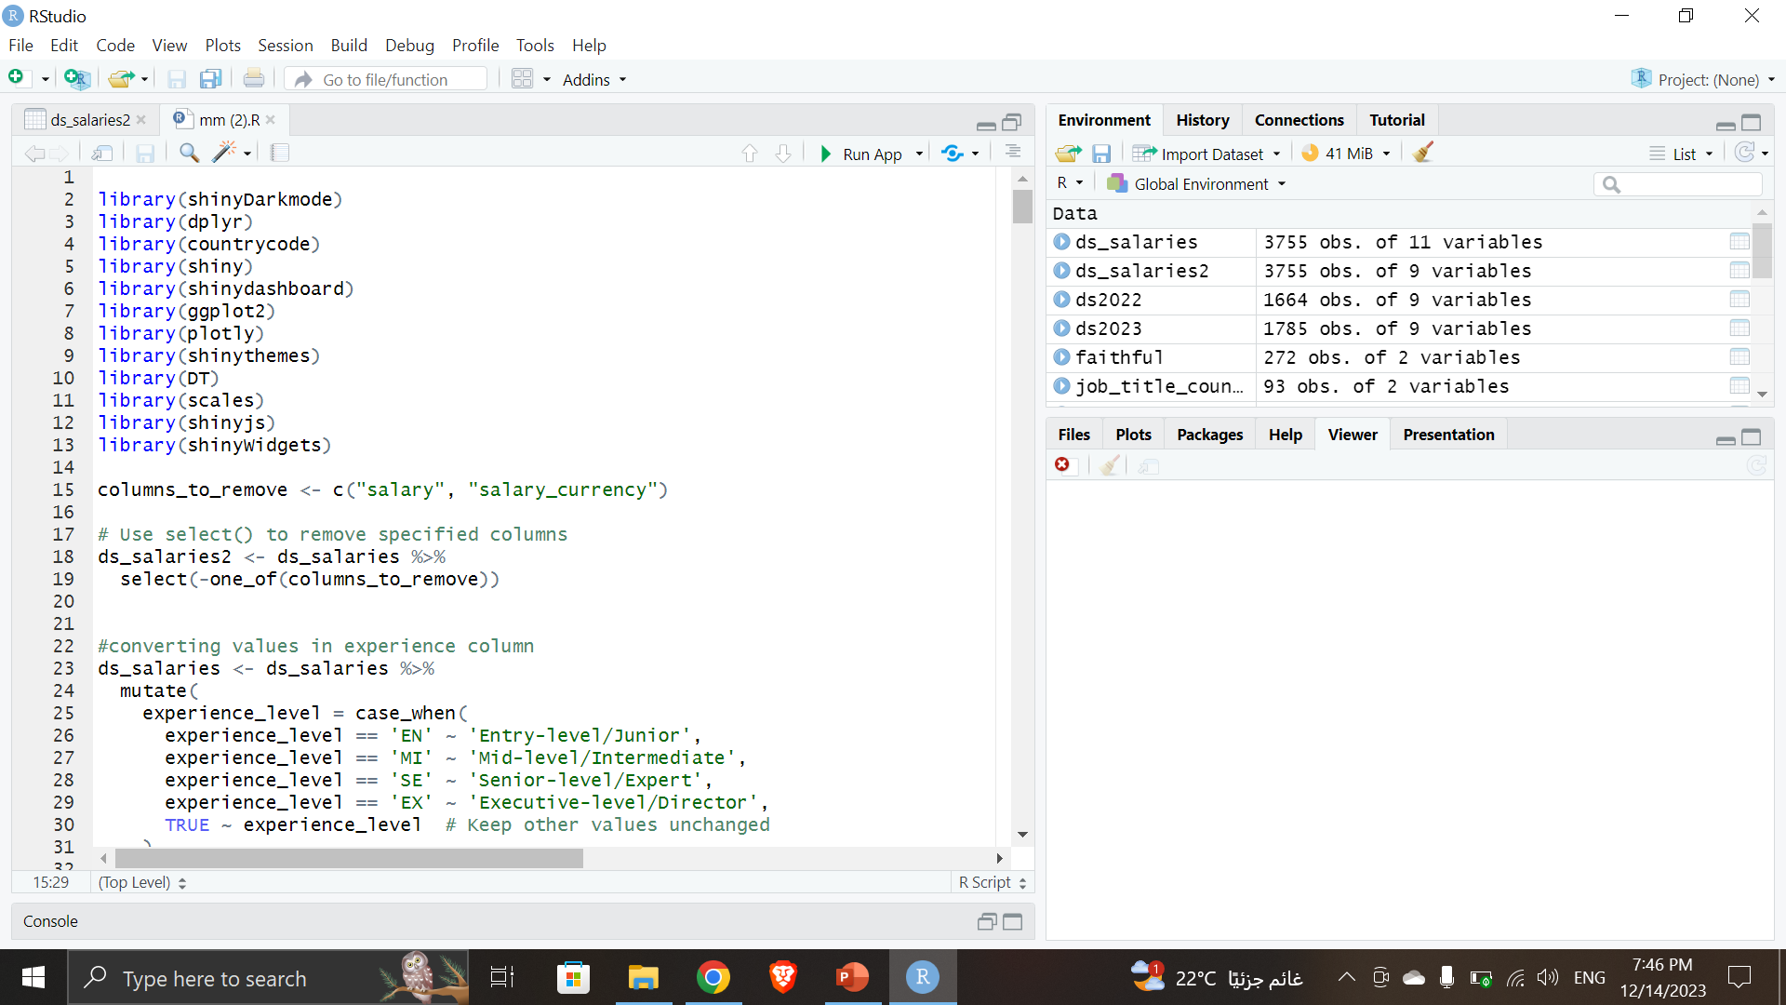
Data PreProcessing
First we removed the two columns “Salary” and “Salary_currency” as they both offered the same functionality as “Salary_in_usd” where salary_in_usd told us which currency and how much each employee get.

Slide 8
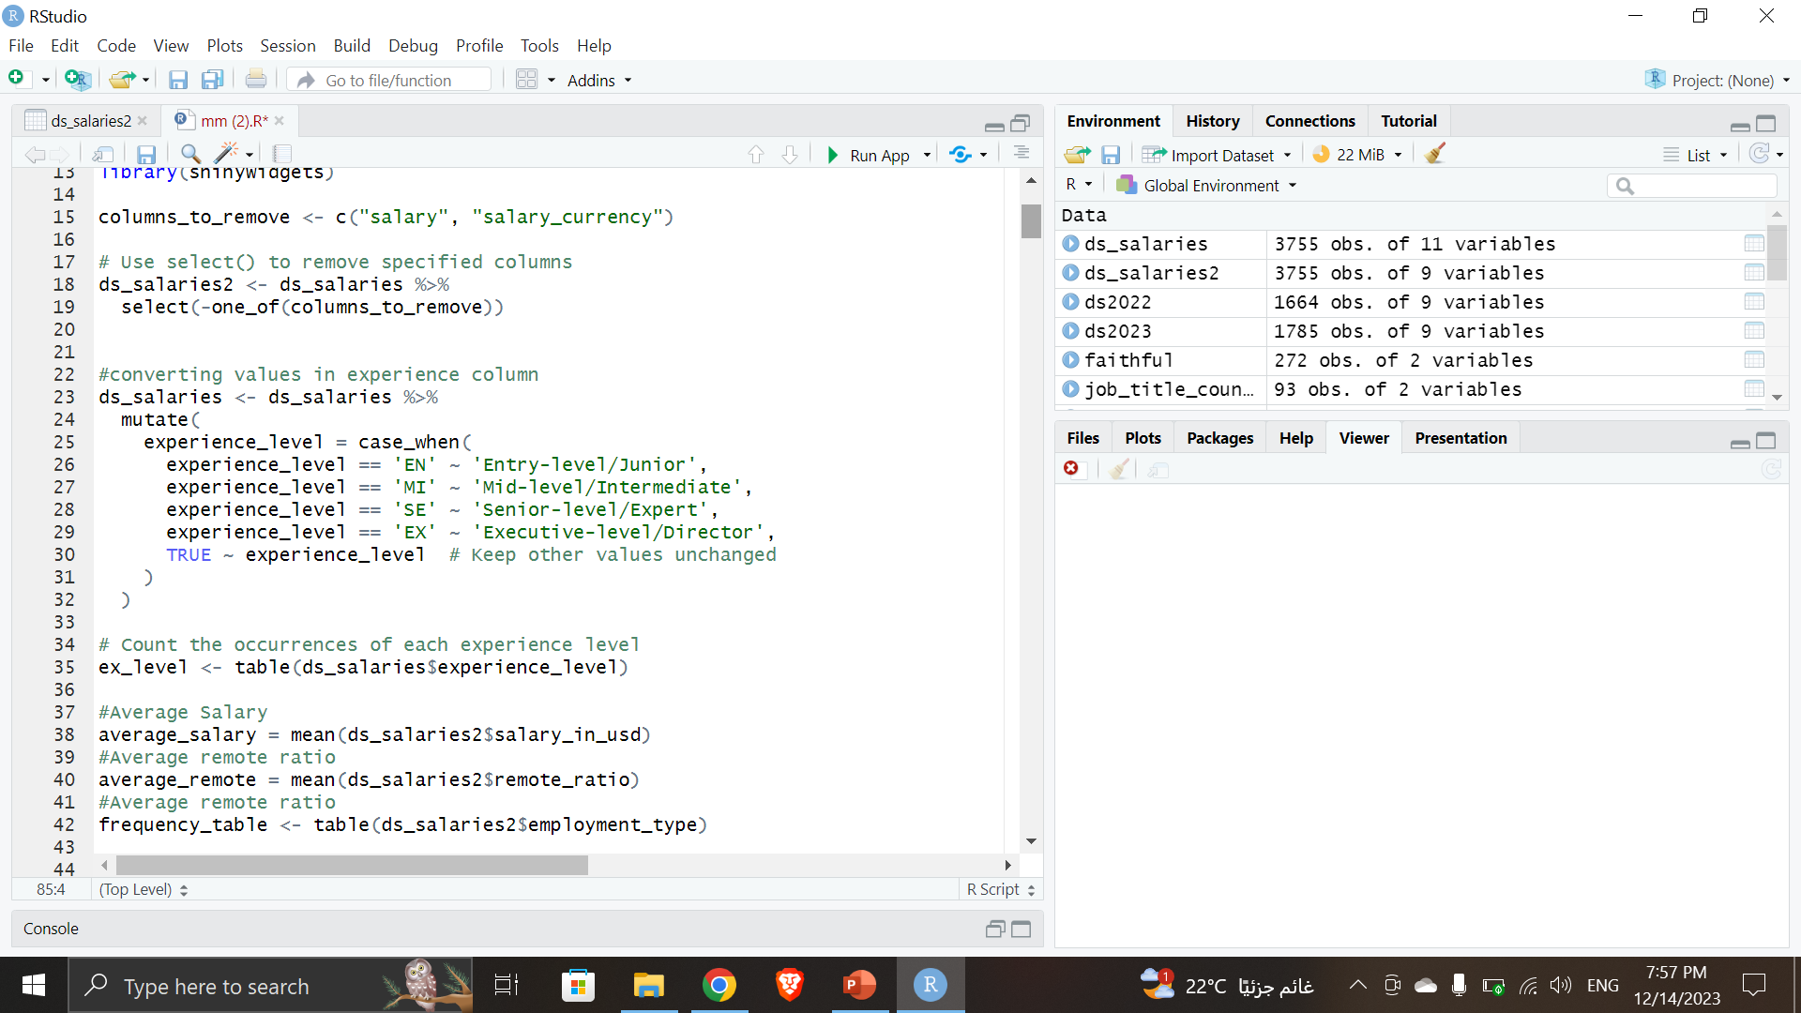
Data PreProcessing
Then we converted values in column “Experience_level” to meaningful values for easier user experience as shown in the image below

Slide 9
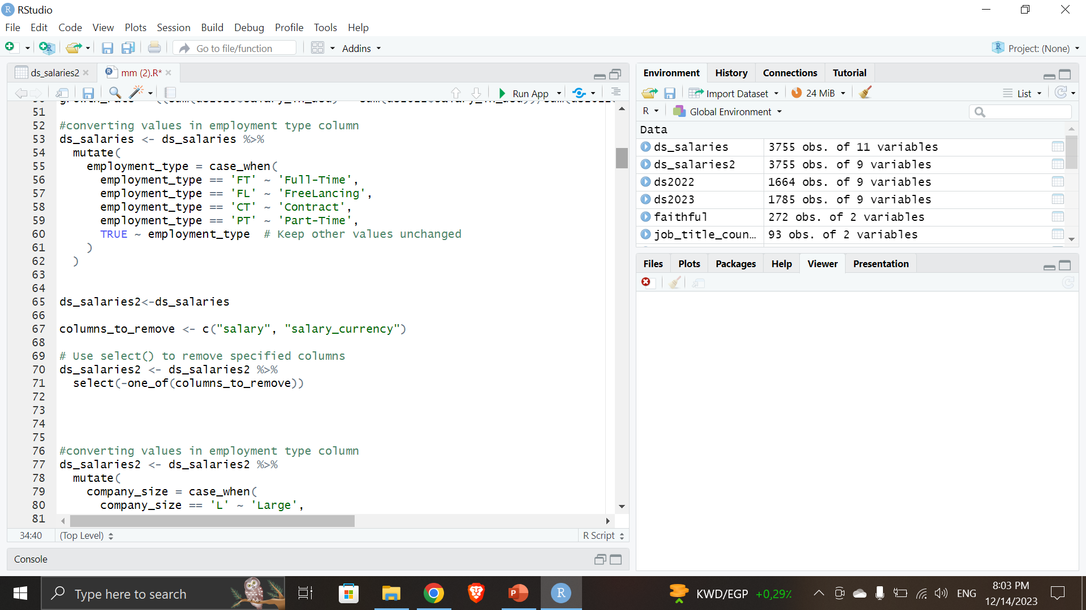
Data PreProcessing
Then we converted values in “employment_type” column to meaningful values for easier user experience as shown in the image below. And copied the ds_salaries dataset to ds_salarie2 for further manipulation

Slide 10
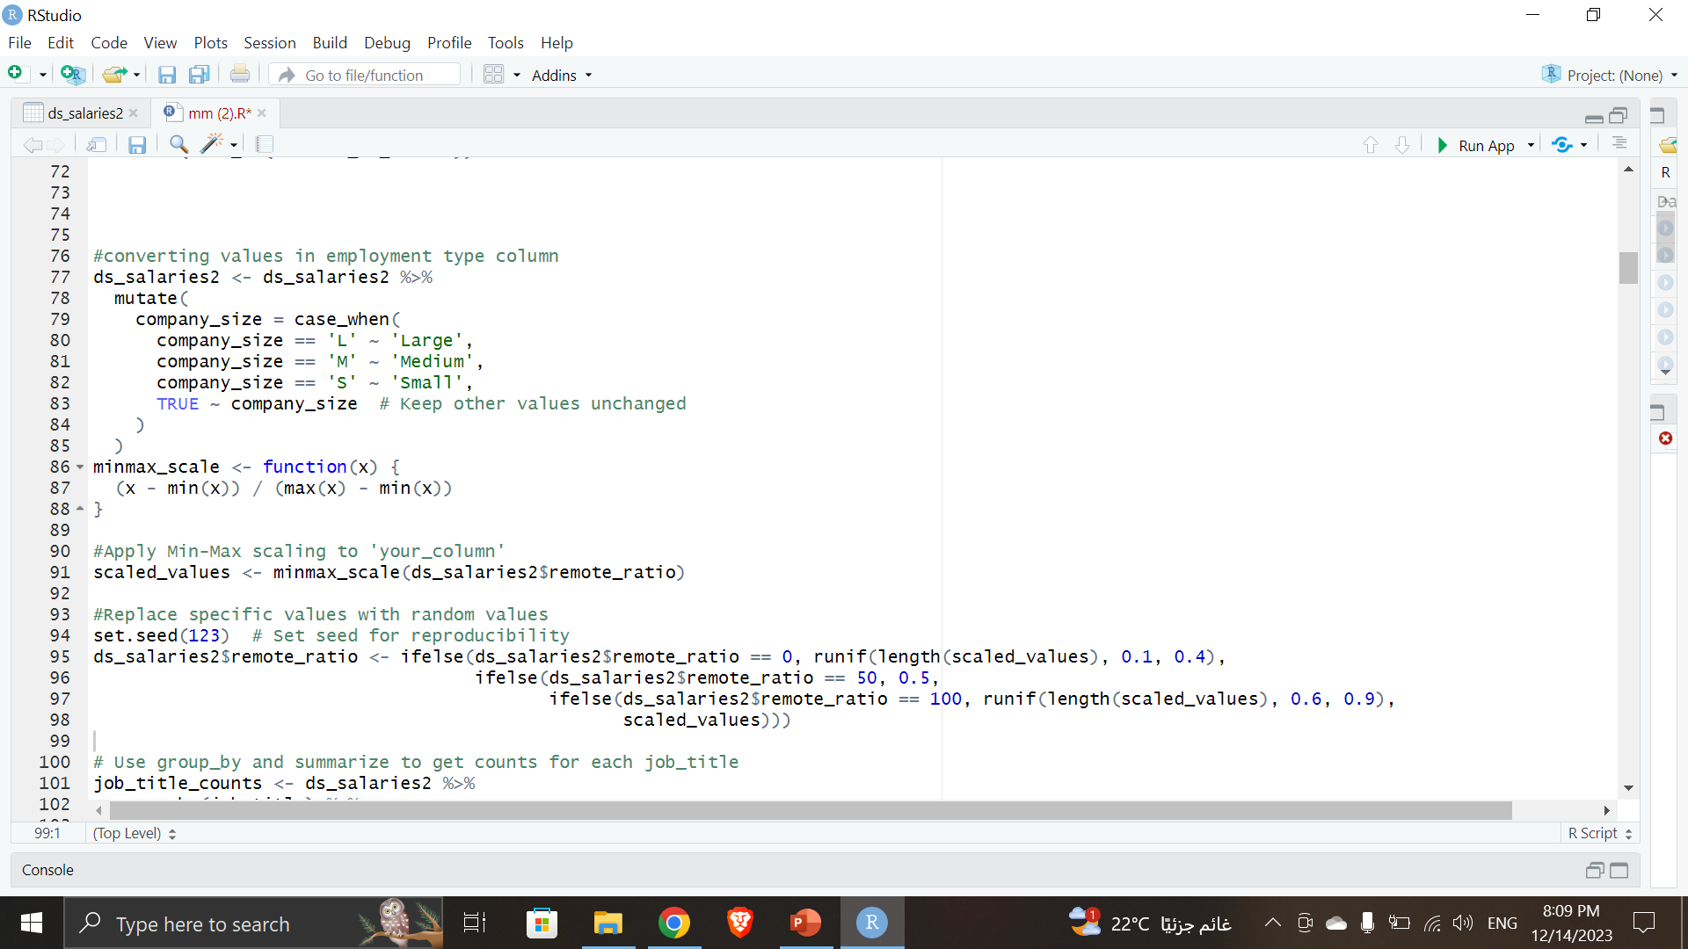
Data PreProcessing
Then we converted values in “Company_Size” column to meaningful values for easier user experience as shown in the image below. And implemented minmax function on the “Remote_Ratio” column for better scaling , to have continuous values for scatter_plot

Slide 11
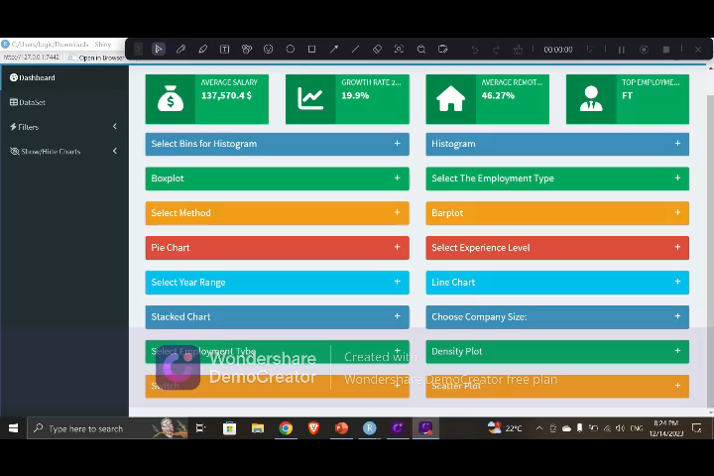
INTERACTIVE SHINY DASHBOARD

Slide 12

Static Visualizations with ggplot2

Slide 13
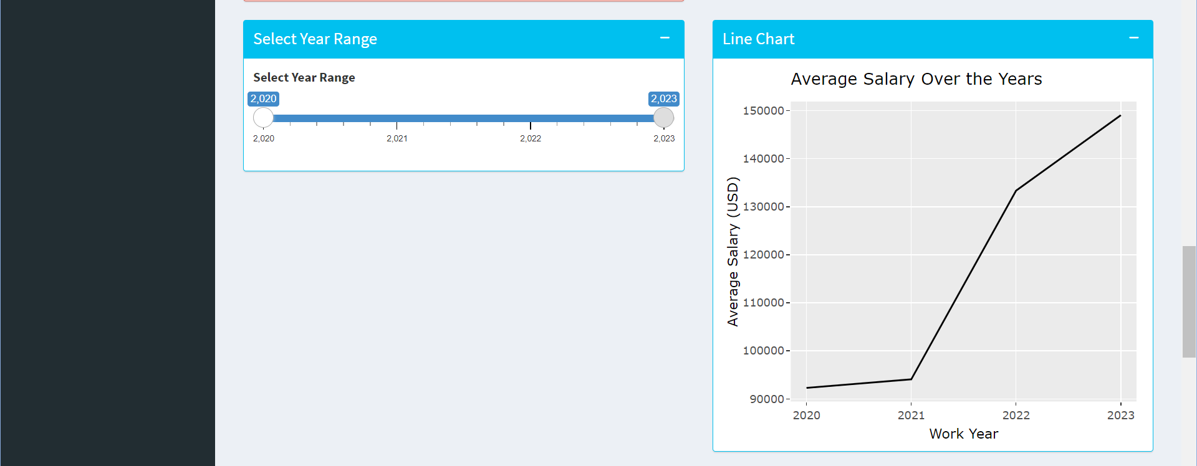
Line Chart
This chart shows the average salaries for employees over the years

Slide 14
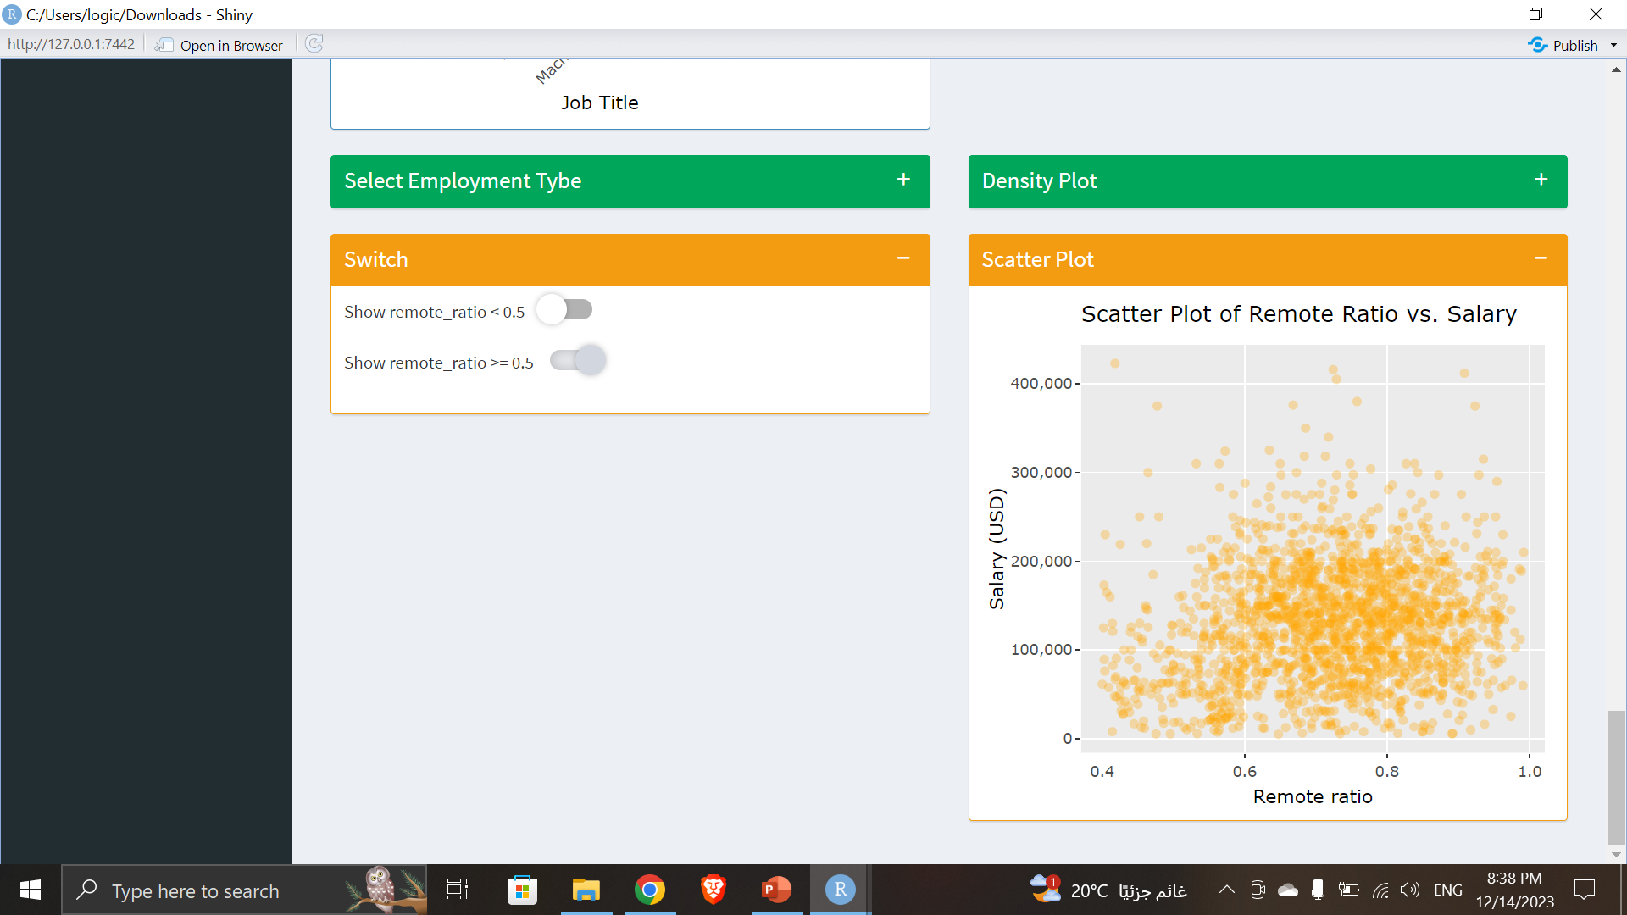
Scatter Plot
This chart shows the how often the employees work on site and from home and how it affects their salary

Slide 15
Thank you

